Slide 1


CMR ENGINEERING COLLEGE
(UGC AUTONOMOUS)
(Accredited by NBA,Approved by AICTE NEW DELHI, Affiliated to JNTU, Hyderabad)
Kandlakoya, Medchal Road, Hyderabad-501 401.
Department of Computer Science & Engineering
Major Project
On
AUTOMATIC ASSESSMENT OF COMMUNICATION SKILLS IN NON-CONVENTIONAL INTERVIEW SETTINGS
Internal Guide:- Mr.Y.Shyam Sundar, Assistant Professor,
Dept. of CSE.
By
J.Anusha
G.Vineeth Kumar
Anwar Hussain
D.Jashwanth
: (208R1A0524)
: (208R1A0521)
: (208R1A0535)
: (208R1A0515)
A.Y 2023-2024

Slide 2
TABLE OF CONTENTS
Abstract
Introduction about Project
Literature Survey
Existing System
Existing System with Limitations
Proposed System
Proposed System and Advantages
Software Requirements
Hardware Requirements
Feasibility Study
Testing Strategies
Technologies and algorithms used
UML Diagrams
Output Screens
Conclusion
Future Enhancements
References

Slide 3
ABSTRACT
Automatic assessment of communication skills in non-conventional interview settings refers to the use of technology to evaluate and analyze the communication abilities of individuals during interactions, especially in unconventional or remote settings. Traditional systems for assessing communication skills in job interviews relied heavily on human judgment. There is a need for automated tools and systems that can accurately evaluate candidates communication abilities in these non-traditional settings.

Slide 4
INTRODUCTION ABOUT PROJECT
Communication is the aptitude to proficiently and expediently transmit information to others.
There exist various forms of communication, including spoken, written, and non-verbal.
The advent of automated assessment tools presents a promising solution, offering the potential to objectively measure and analyze communication skills in diverse and unconventional interview formats.

Slide 5
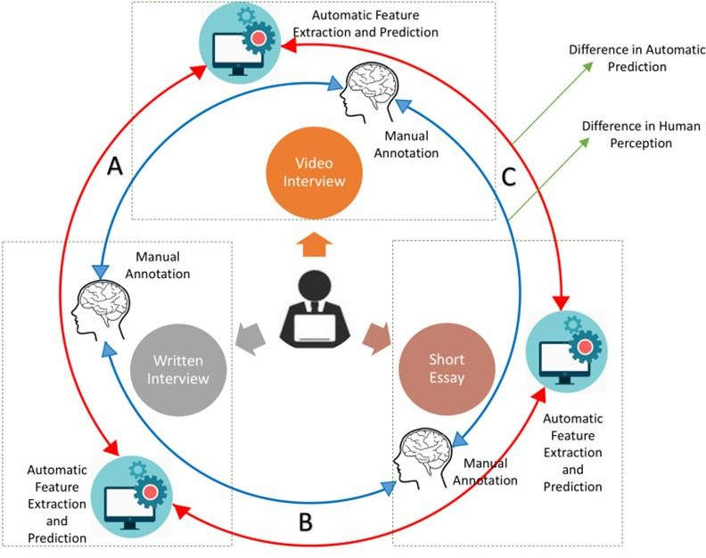
Figure 1: Non-conventional Interview System. Blue lines - Differences in human perception, red lines - Differences in automatic features and prediction, (A) Between the Video and Written interview (B) Between Written interview and Short Essay (C) Between Video interview and Short Essay

Slide 6
LITERATURE SURVEY
The development of an automated interview scoring system for evaluating communication skills involves the integration of multiple disciplines, encompassing research in areas such as computer-assisted education, automatic video assessment, automated content scoring, and affective computing.
Batrinca et al. proposed an automated method for predicting personality traits by extracting auditory features and manually extracting visual features.
Higgins et al. extend their investigation beyond the utilization of manual features that are relevant to the query and delve into the examination of features that are informed by syntax.
Several further models, such as the E-rater, Intelligent Essay Assessor, Bayesian Essay Test Scoring System, and IntelliMetric, have been developed and proven to be successful.

Slide 7
EXISTING SYSTEM
In the traditional system, assessing communication skills during job interviews or similar interactions relied heavily on human judgment. Interviewers evaluated candidates based on verbal communication, body language, responses to questions, and overall presentation during face-to-face interviews.
These assessments were typically subjective and based on the interviewer's personal biases and perceptions.

Slide 8
EXISTING SYSTEM WITH LIMITATIONS
Traditional assessments are highly subjective and can be influenced by the interviewer's biases, leading to inconsistent and unfair evaluations.
Candidates may not receive specific details about their strengths and weaknesses, hindering their ability to improve their communication skills.

Slide 9
PROPOSED SYSTEM
In the proposed system, predictions are based on video, audio, and written essay questions, and answers.
The proposed system enables the automatic assessment of communication skills in non-conventional interview settings, allowing users to receive feedback on their visual expressions, spoken content, and written communication skills.
In the case of video monitoring, the proposed system utilizes facial expressions to determine whether a candidate is confident or confused. For audio monitoring, candidate audio files are uploaded and processed to extract Mel-frequency cepstral coefficients (MFCC) features.In the context of essay writing, the system extracts relevant features from the text and utilizes the XGBOOST algorithm to predict essay writing skills.

Slide 10
PROPOSED SYSTEM AND ADVANTAGES
The system provides objective assessments of communication skills, eliminating human biases and ensuring fairness in the evaluation process.
Automated assessments are much faster than manual evaluations, allowing employers to assess a large number of candidates efficiently, particularly in high-volume recruitment scenarios.
Automated systems produce consistent evaluation results, ensuring that each candidate is assessed using the same criteria and standards.

Slide 11
SOFTWARE REQUIREMENTS
Coding Language : Python
Graphics Requirement : Jupiter
User Documentation : Google colab

Slide 12
HARDWARE REQUIREMENTS
Operating system : Windows, Linux
Processor : minimum intel i3
Ram : minimum 4 GB
Hard disk : minimum 250GB

Slide 13
FEASIBILITY STUDY
Preliminary investigation examines project feasibility, the likelihood the system will be useful to the organization.
There are aspects in the feasibility study portion of the preliminary investigation:
Technical feasibility
Operational feasibility
Economic feasibility

Slide 14
FEASIBILITY STUDY
Technical Feasibility:
The project is technically feasible, utilizing state-of-the-art machine learning, NLP, and computer vision technologies. It employs well-known algorithms like XGBOOST and deep learning frameworks such as TensorFlow and PyTorch, alongside MFCC for audio processing and computer vision for facial analysis. The availability of these mature technologies and strong community support ensures the project's technical groundwork is solid and achievable.
Operational Feasibility:
The project is operationally viable, offering a new method for automated, objective assessment of communication skills in non-traditional interview contexts. It promises to enhance recruitment workflows by minimizing subjective bias. The system is designed for easy adoption and operational efficiency, reinforcing its practical applicability and potential for widespread acceptance.

Slide 15
FEASIBILITY STUDY
Economic Feasibility:
The project is economically feasible, promising cost savings and improved recruitment efficiency by automating communication skills assessments. This not only reduces manual effort by HR but also aims to enhance hiring quality, potentially lowering turnover and related expenses. Despite initial costs for development and implementation, the expected gains in process efficiency and decision-making are likely to compensate for these investments, supporting the project's financial viability.

Slide 16
TESTING STRATEGIES
System Testing :When the software is developed before it is given to user to user the software must be tested whether it is solving the purpose for which it is developed. This testing involves various types through which one can ensure the software is reliable.
Module Testing: To locate errors, each module is tested individually. This enables us to detect error and correct it without affecting any other modules.
Integration Testing: After the module testing, the integration testing is applied. When linking the modules there may be chance for errors to occur, these errors are corrected by using this testing.
Acceptance Testing: When that user fined no major problems with its accuracy, the system passers through a final acceptance test.

Slide 17
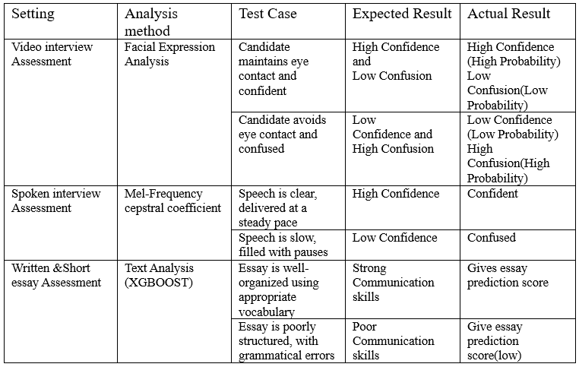

Slide 18
TECHNOLOGIES AND ALGORITHMS USED
Facial Expression Analysis: This technique uses computer vision algorithms to analyze facial features like eye contact, smiles, frowns, etc., to infer a candidate's emotional state (confidence, confusion, etc.).
Mel-Frequency Cepstral Coefficients (MFCC) Analysis: This technique extracts features from audio recordings that capture properties of speech like pitch, energy, and timbre. These features can be used to assess characteristics like fluency, hesitation, and vocal variety.
Text Analysis: This technique employs Natural Language Processing (NLP) to analyze written text (essays, chat transcripts) for features reflecting communication skills. It might consider vocabulary richness, sentence structure, grammar, and the use of appropriate language for the context.

Slide 19
TECHNOLOGIES AND ALGORITHMS USED
XGBOOST: This is a machine learning algorithm used for classification and regression tasks. In this context, it's likely used to analyze extracted features (from text, audio, or video) and predict communication skills on a scale or categorize them (e.g., strong, average, weak).
Deep Learning: This refers to a class of machine learning algorithms inspired by the structure and function of the brain. Deep learning models can be trained on large datasets of labeled interviews to automatically learn complex patterns in video, audio, and text data that correlate with communication skills.

Slide 20
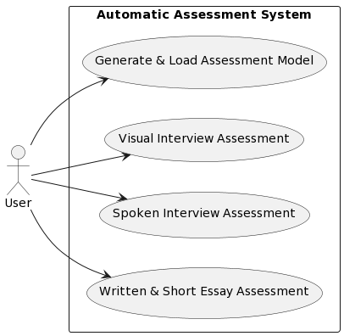
USE CASE DIAGRAM

Slide 21
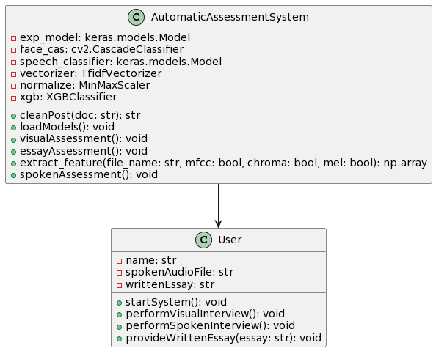
CLASS DIAGRAM

Slide 22
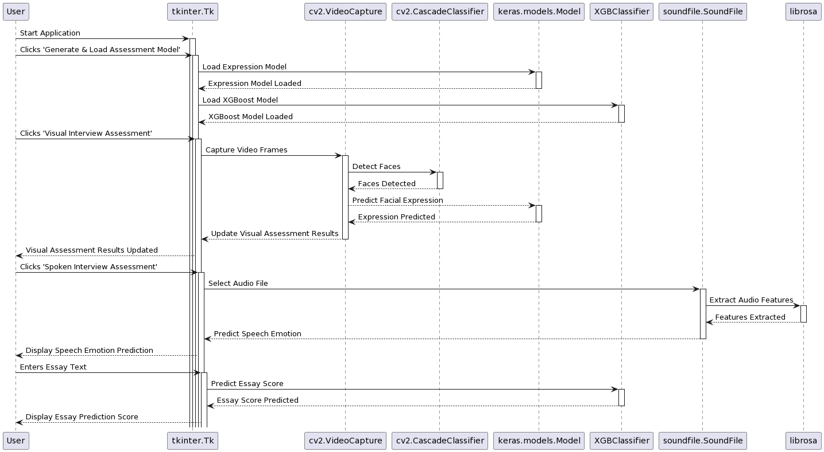
SEQUENCE DIAGRAM

Slide 23
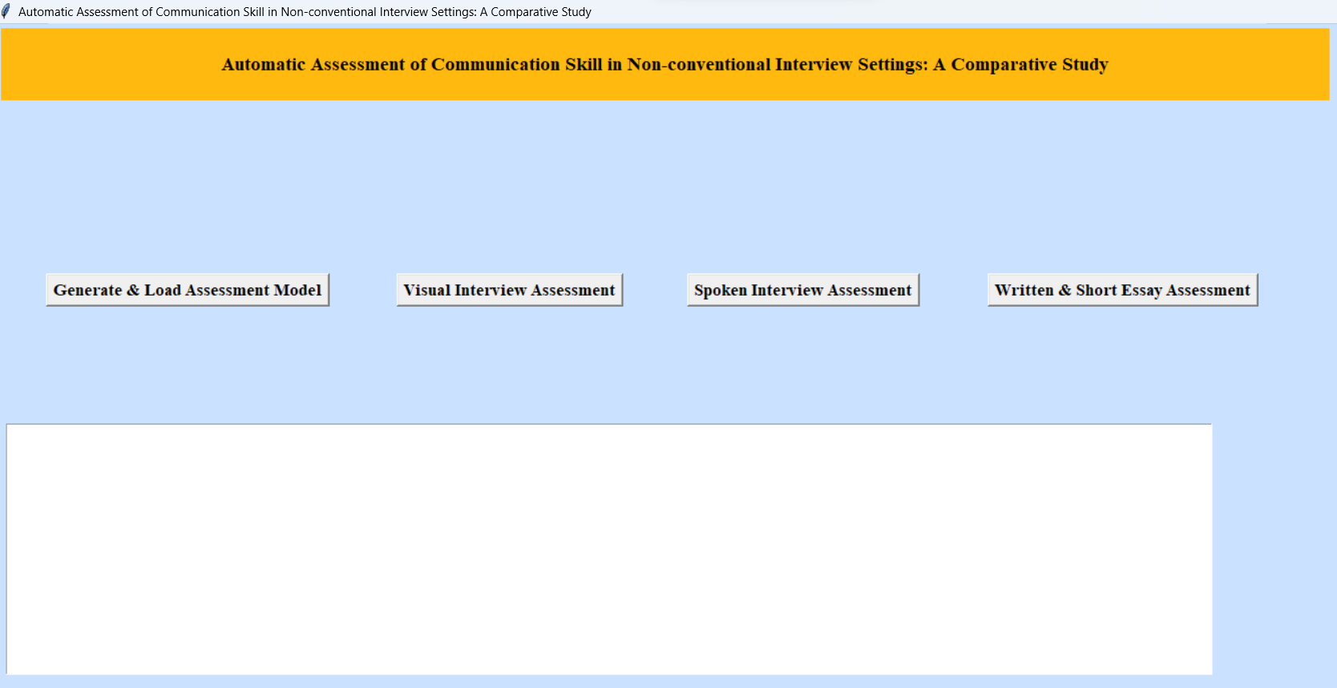
OUTPUT SCREENS

Slide 24
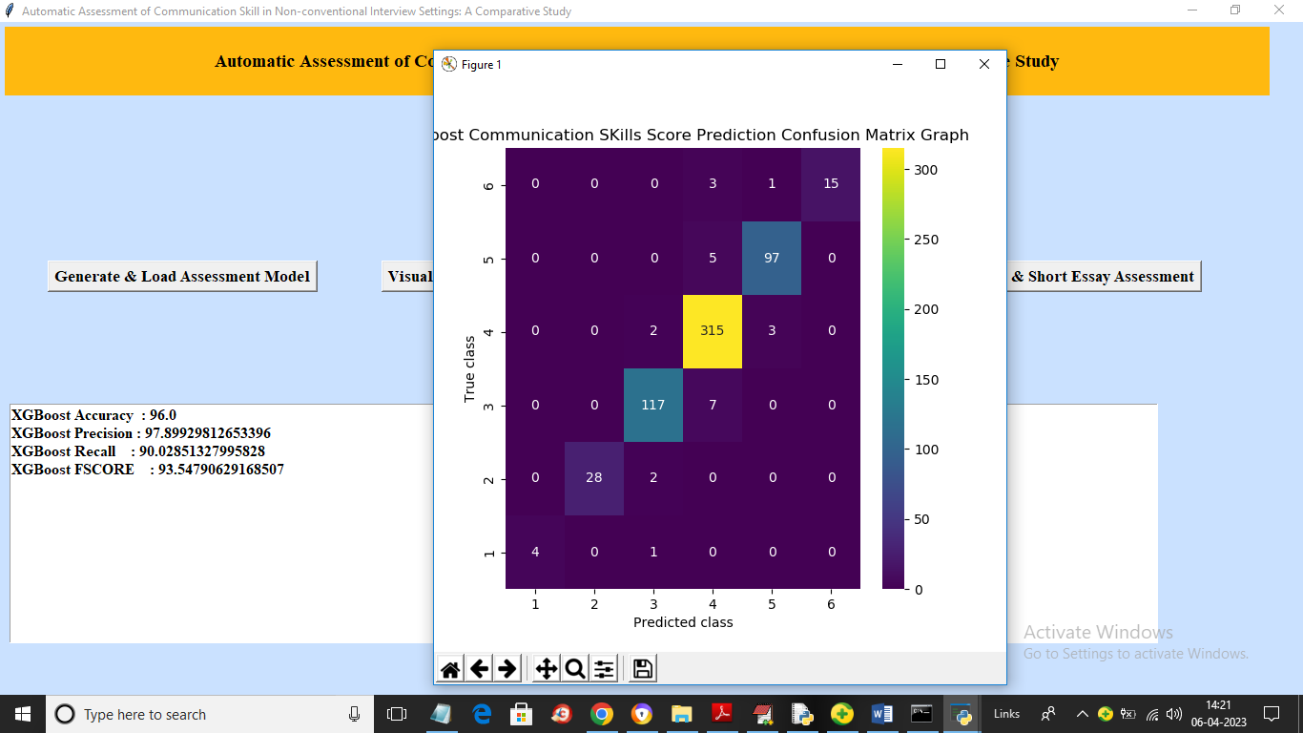

Slide 25
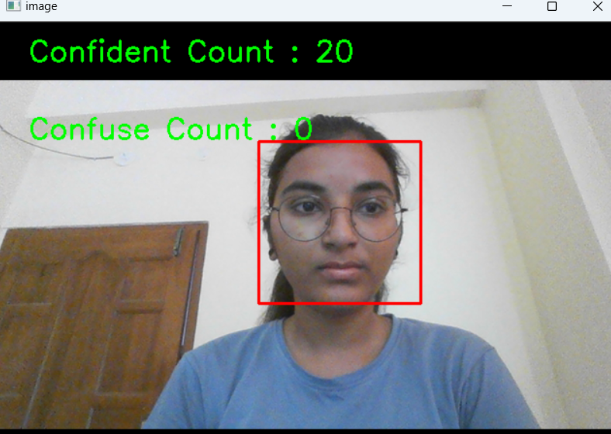

Slide 26
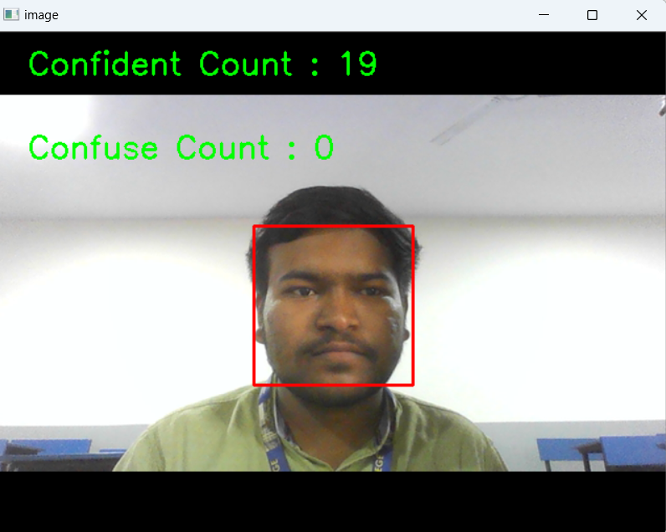

Slide 27
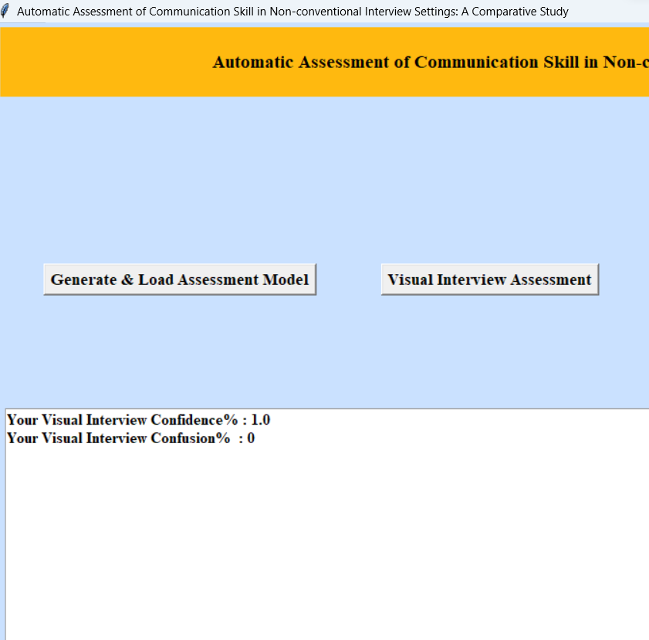

Slide 28
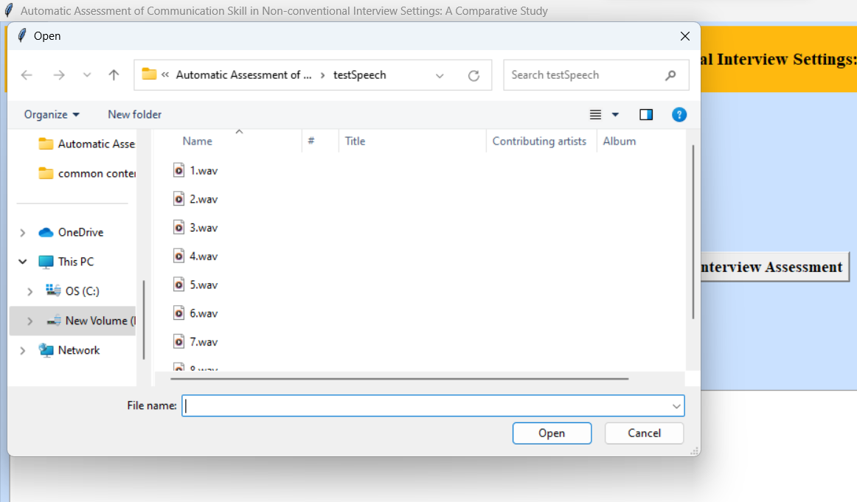

Slide 29
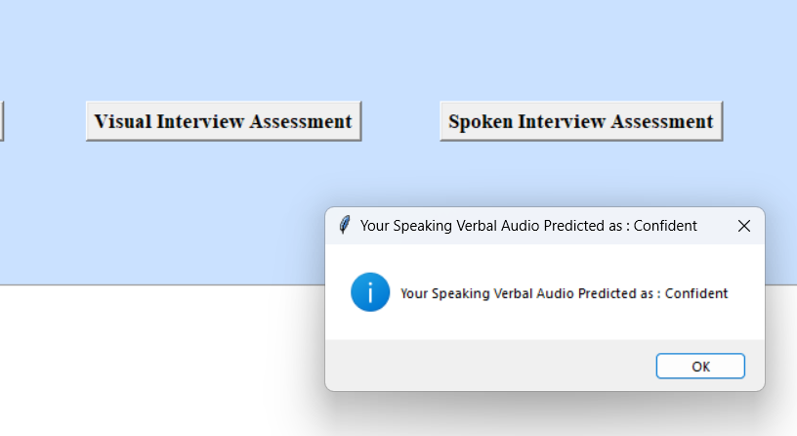

Slide 30
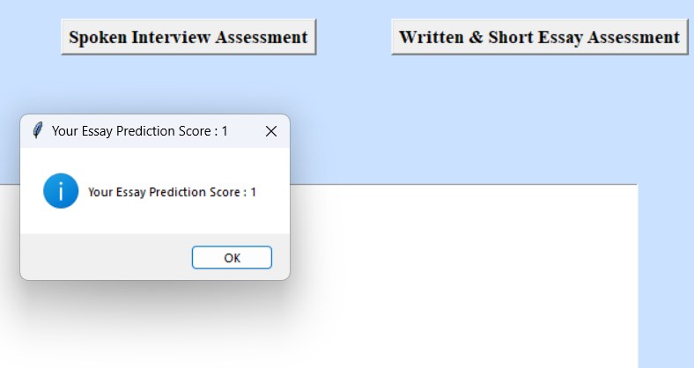

Slide 31
CONCLUSION
In Conclusion, the automatic assessment project for communication skills in non-conventional interviews leverages advanced technology to enhance objectivity and efficiency.
By integrating natural language processing and machine learning, the project aims to revolutionize how we evaluate candidates in diverse interview settings, ensuring fair and informed hiring decisions in the rapidly evolving landscape of modern employment.

Slide 32
FUTURE ENHANCEMENTS
In the future, the automatic assessment of communication skills in non-conventional interview settings is set to revolutionize with innovations such as advanced NLP for deeper understanding .The continuous improvement and refinement of this automated assessment system will be essential. Feedback from users and the analysis of assessment data will guide future enhancements, ensuring the system remains aligned with the dynamic requirements of the job market.

Slide 33
REFERENCES
2016. Discover Big Voice Intelligence. https://www.voicebase.com/ products-features/. (2016).
Yigal Attali and Jill Burstein. 2006. Automated essay scoring with e-rater® V. 2. The Journal of Technology, Learning and Assessment 4, 3 (2006).
Iftekhar Naim, M Iftekhar Tanveer, Daniel Gildea, and Mohammed Ehsan Hoque. 2015. Automated prediction and analysis of job interview performance: The role of what you say and how you say it. In Automatic Face and Gesture Recognition (FG), 2015 11th IEEE International Conference and Workshops on, Vol. 1. IEEE, 1–6.

Slide 34


